Slide 1
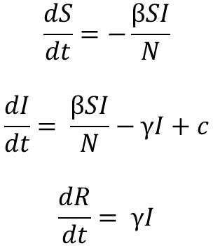
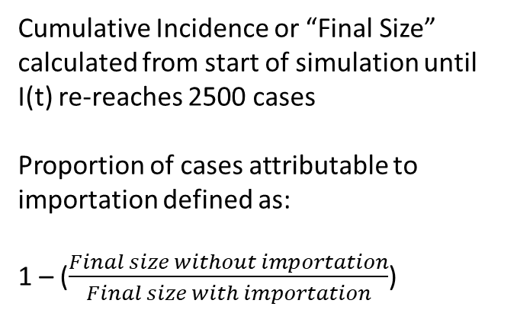
Model Structure
$$\frac{dS}{dt}=−\frac{βSI}{N}$$
$$\frac{dI}{dt}= \frac{βSI}{N}−γI+c$$
$$\frac{dR}{dt}= γI$$
Cumulative Incidence or “Final Size” calculated from start of simulation until I(t) re-reaches 2500 cases
Proportion of cases attributable to importation defined as:
1 – ($\frac{Final size without importation}{Final size with importation}$)
Initial Conditions
N = 5000000
S = 4997500
I = 2500
R = 0
Parameters
Doubling Time = 3 days
Gamma = 4997500
Beta = Varies (1.1 < R < 2.0)
Infectious Importations per day (c) = 25 per day

Slide 2
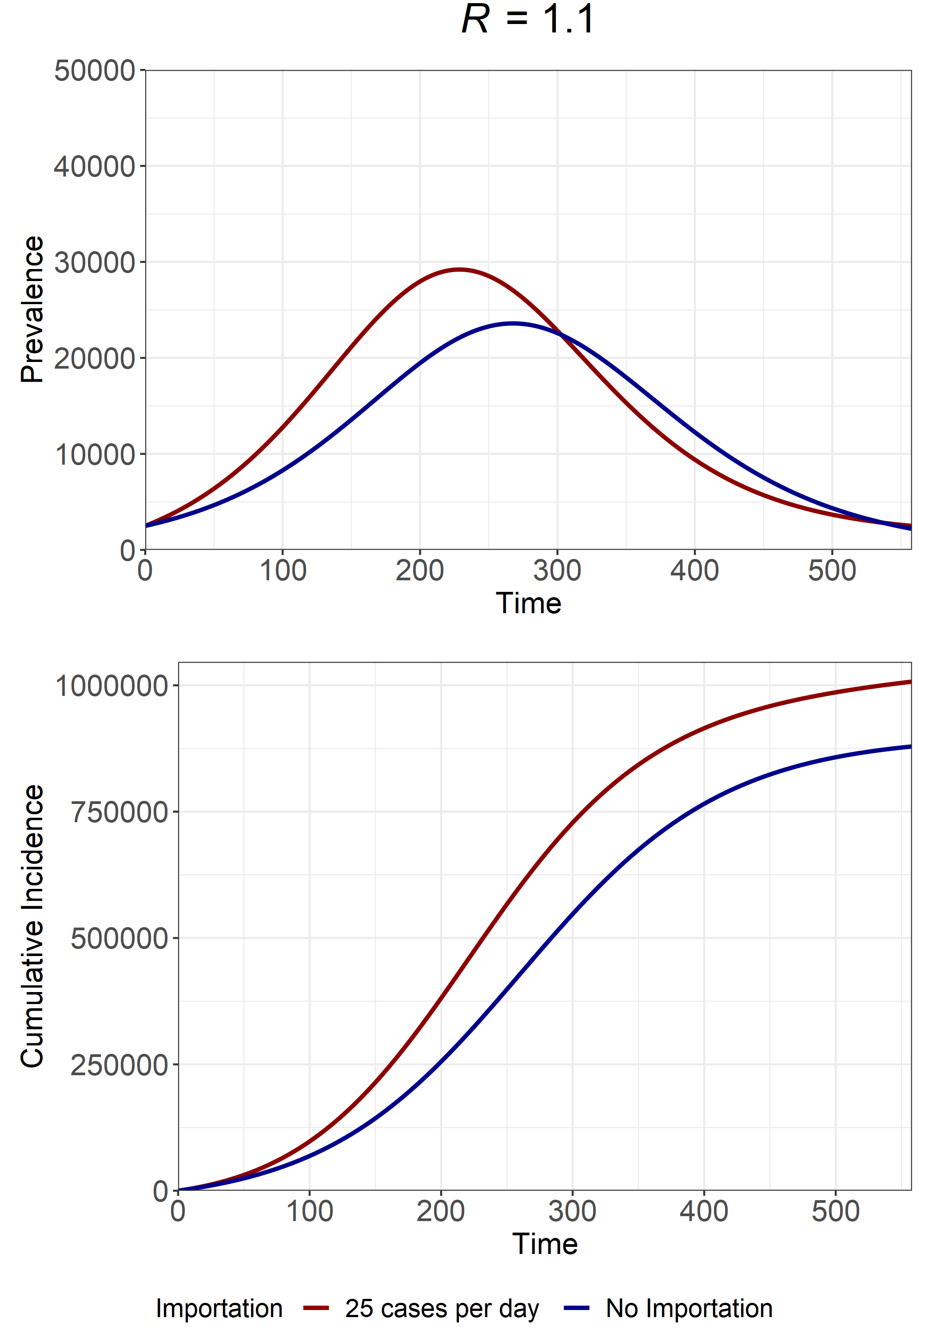
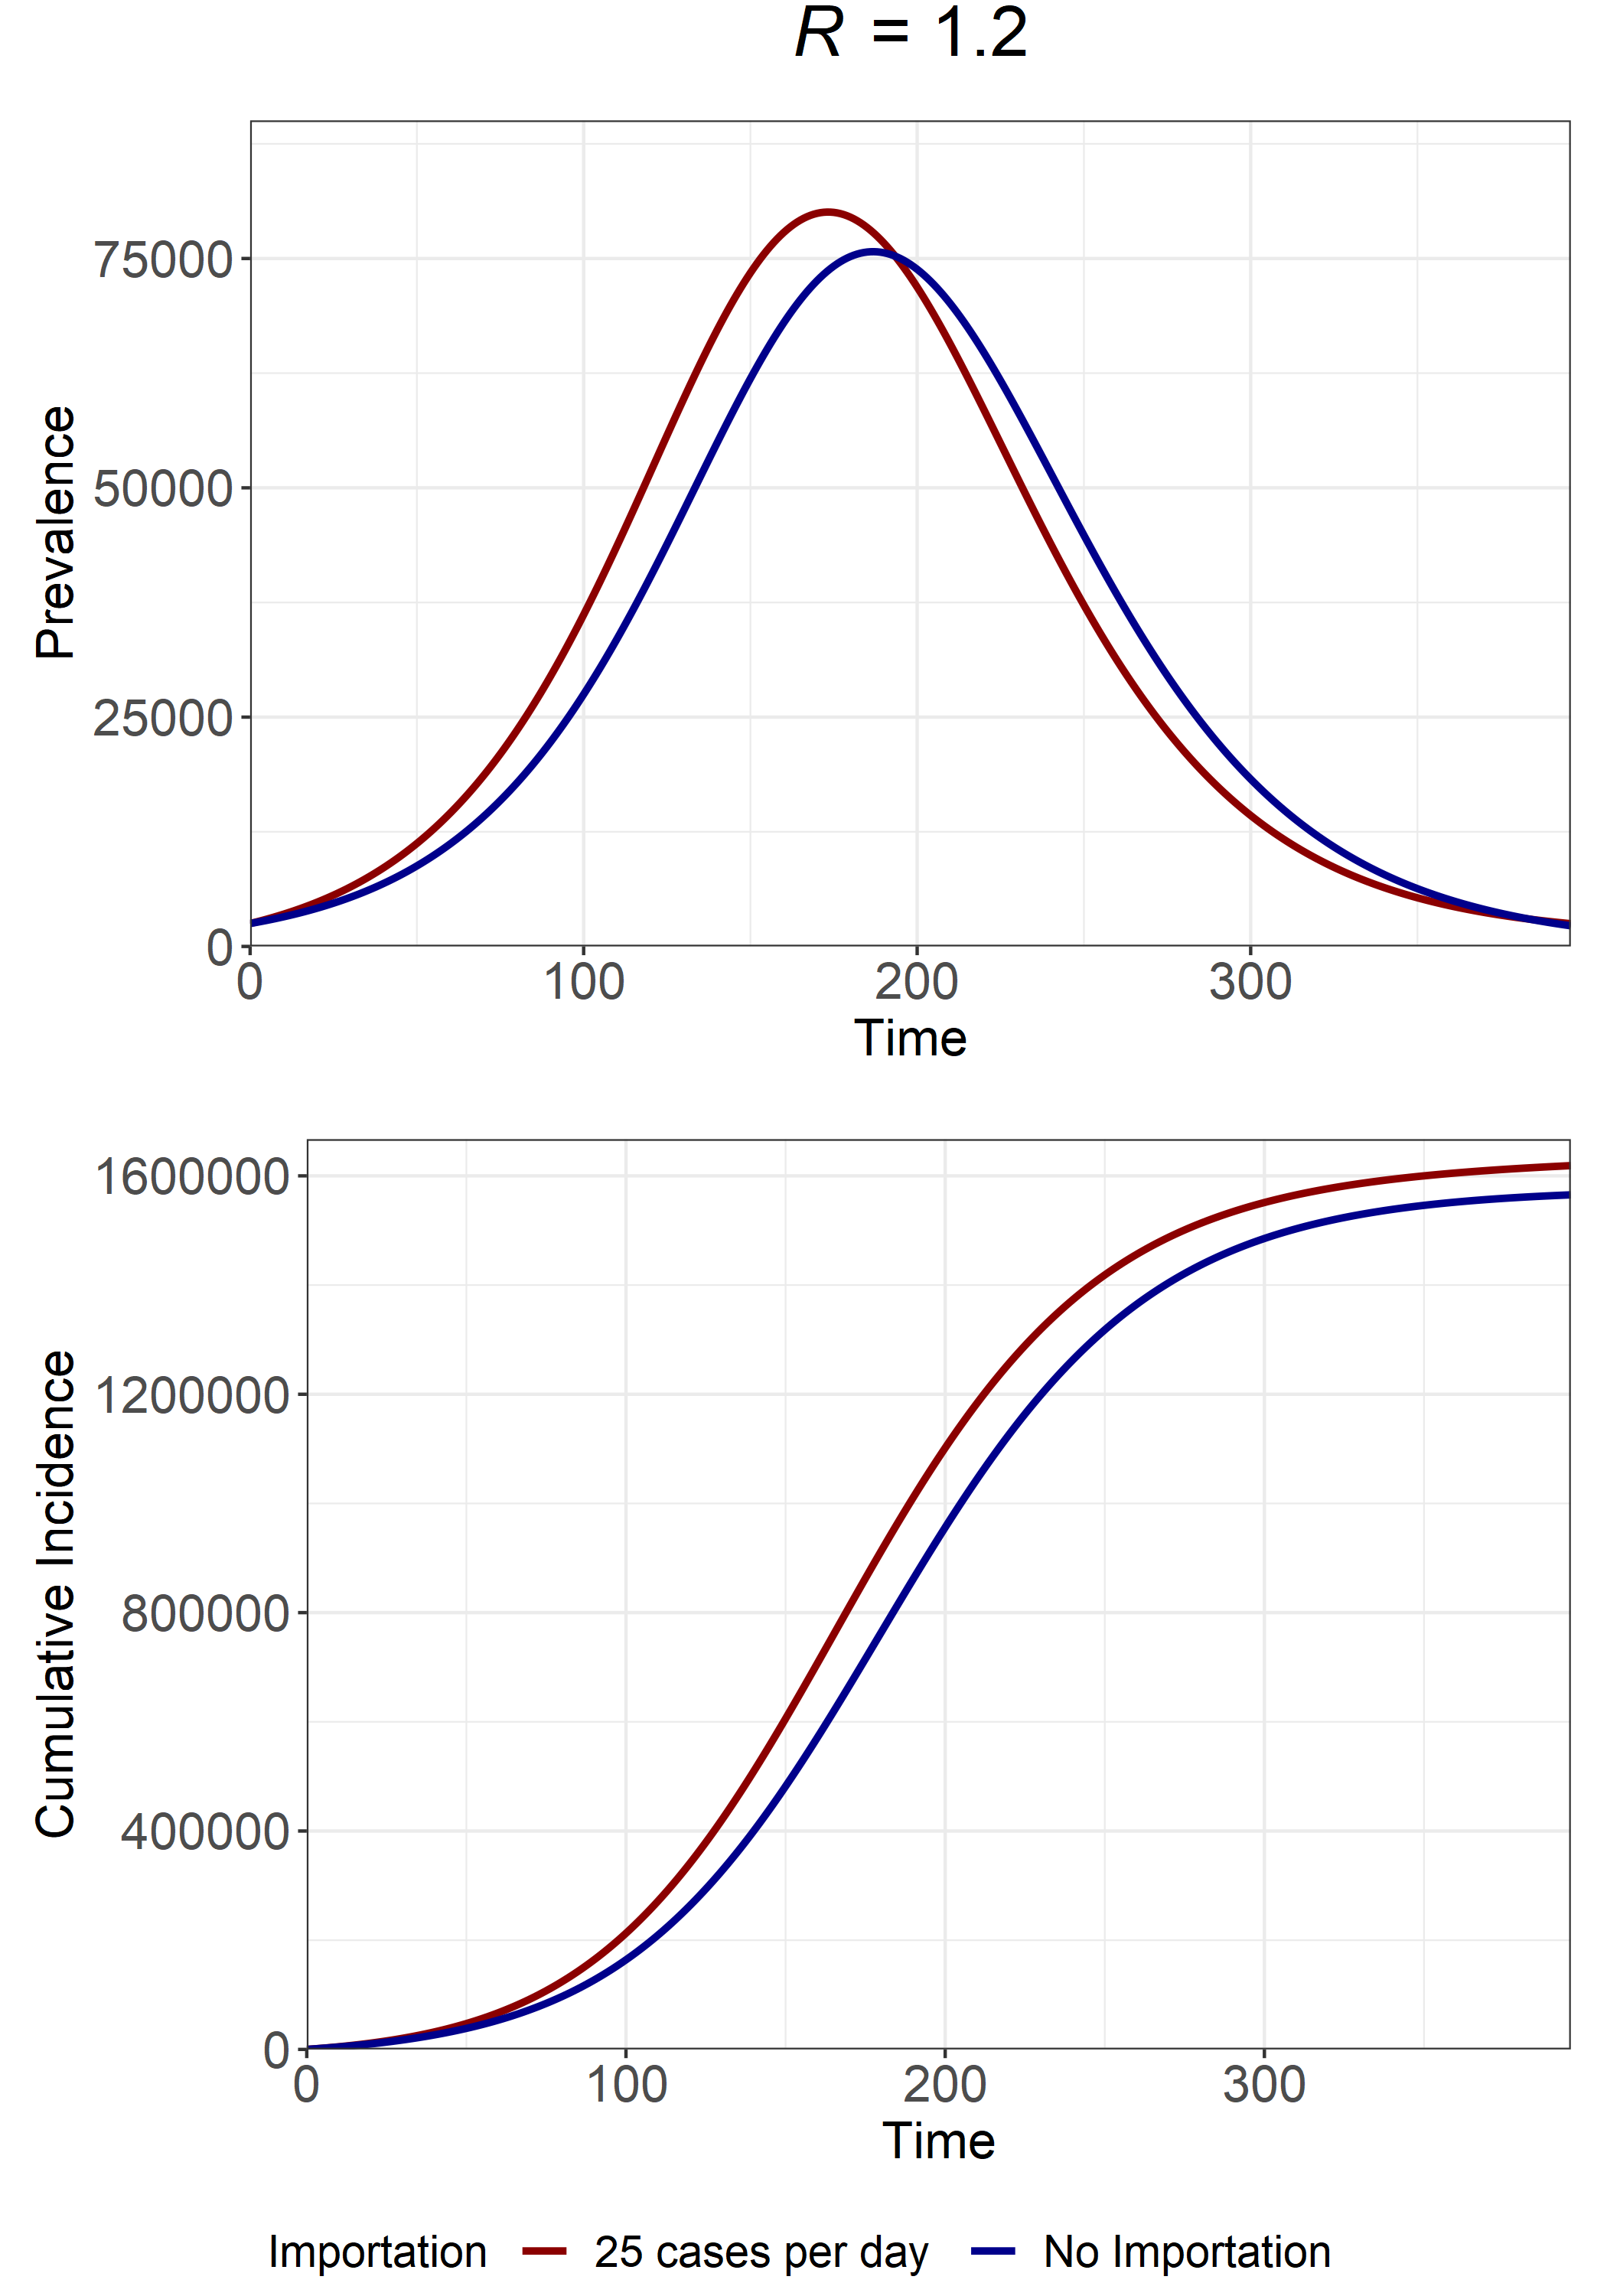
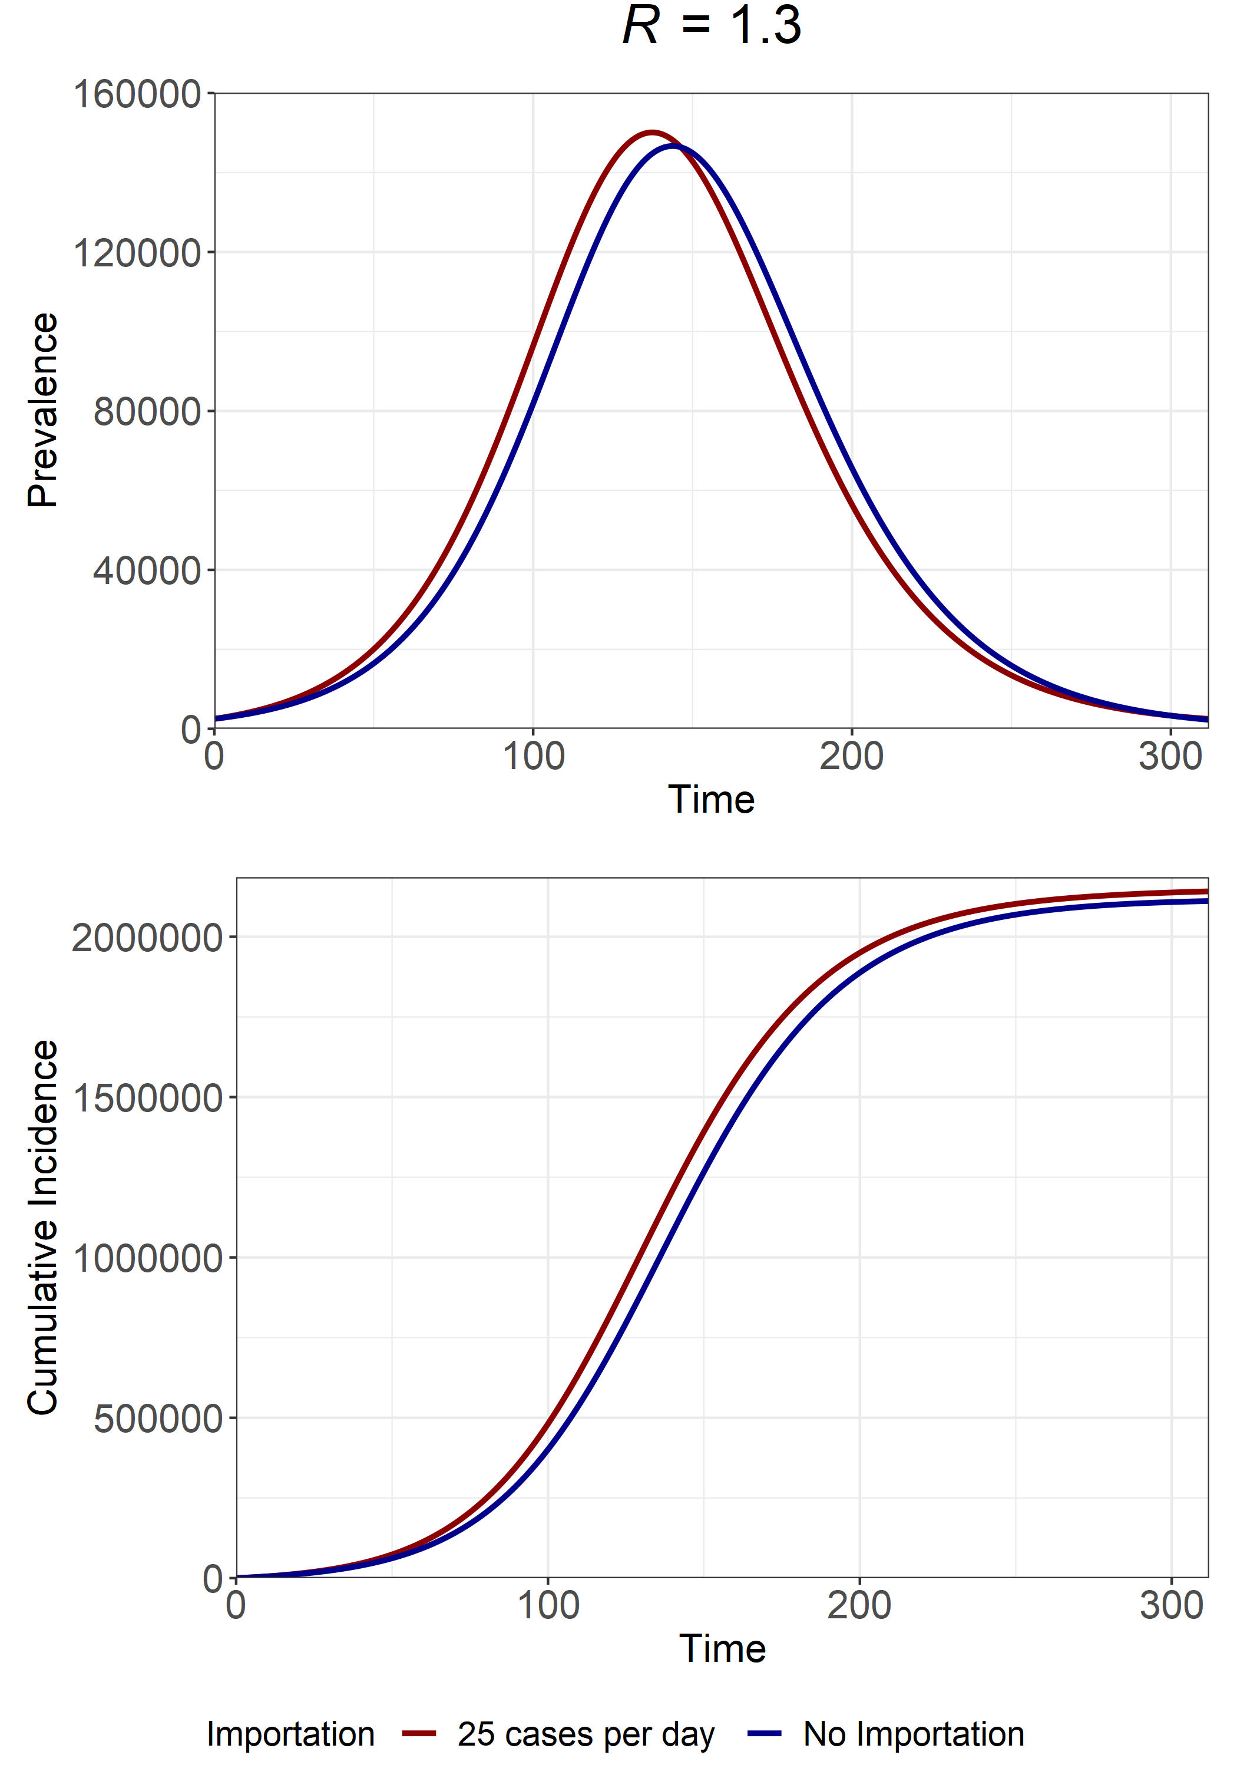
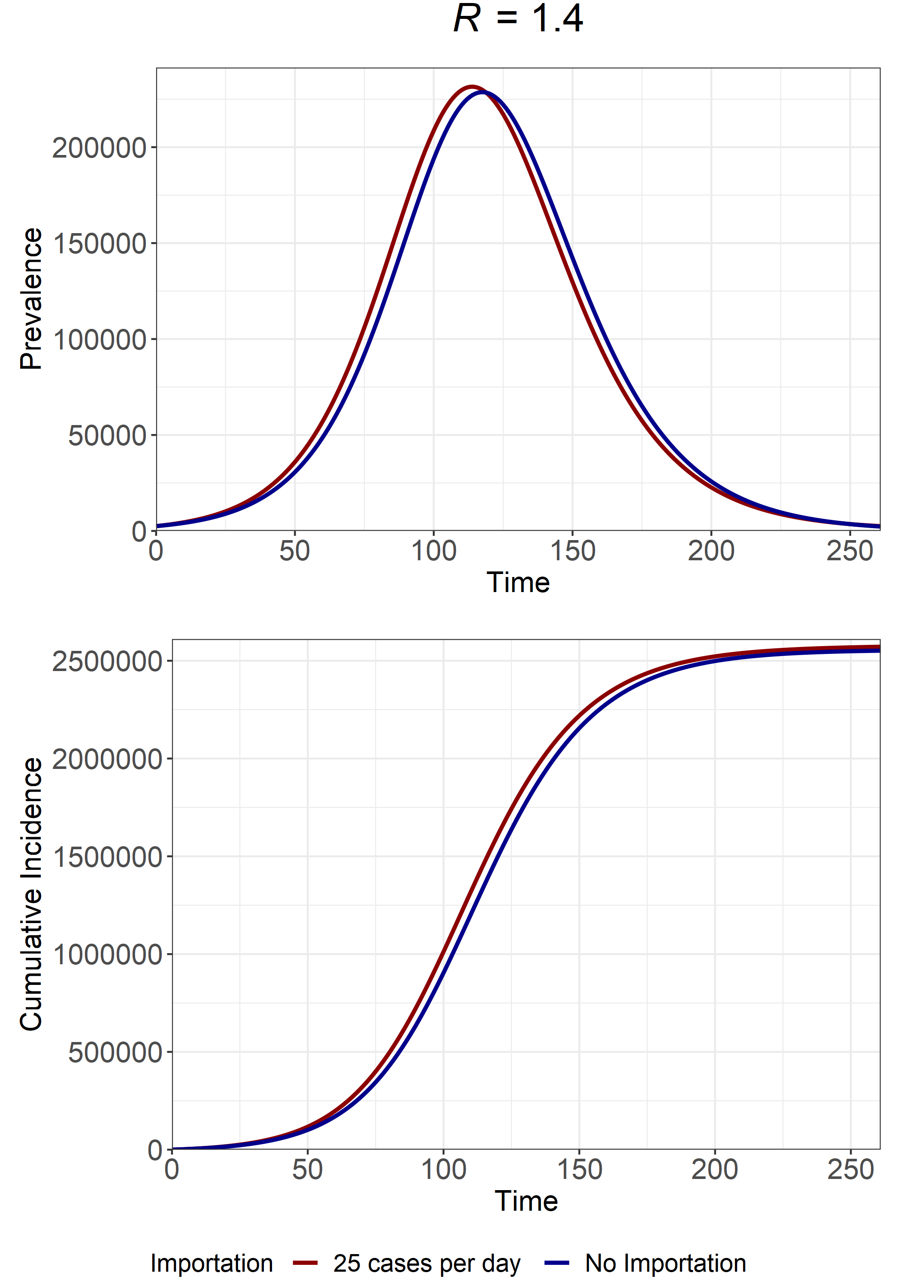
R
1.1
1.2
1.3
1.4
Final Size at I(t) = 2500
Importation = 1004134 cases
No Importation = 876246 cases
Importation = 1617564 cases
No Importation = 1564216 cases
Importation = 2140768 cases
No Importation = 2110689 cases
Importation = 2571107 cases
No Importation = 2551098 cases
Fraction of Epidemic w/ Importation attributable to Importation?
12.7%
3.2%
1.4%
0.78%

Slide 3
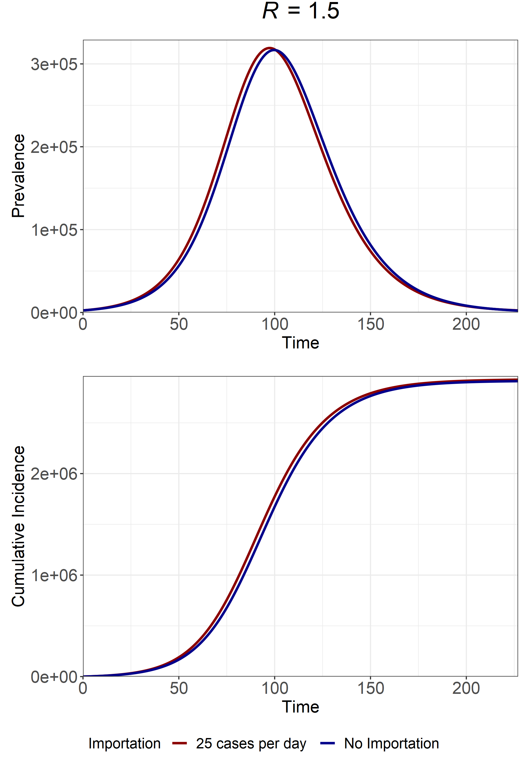
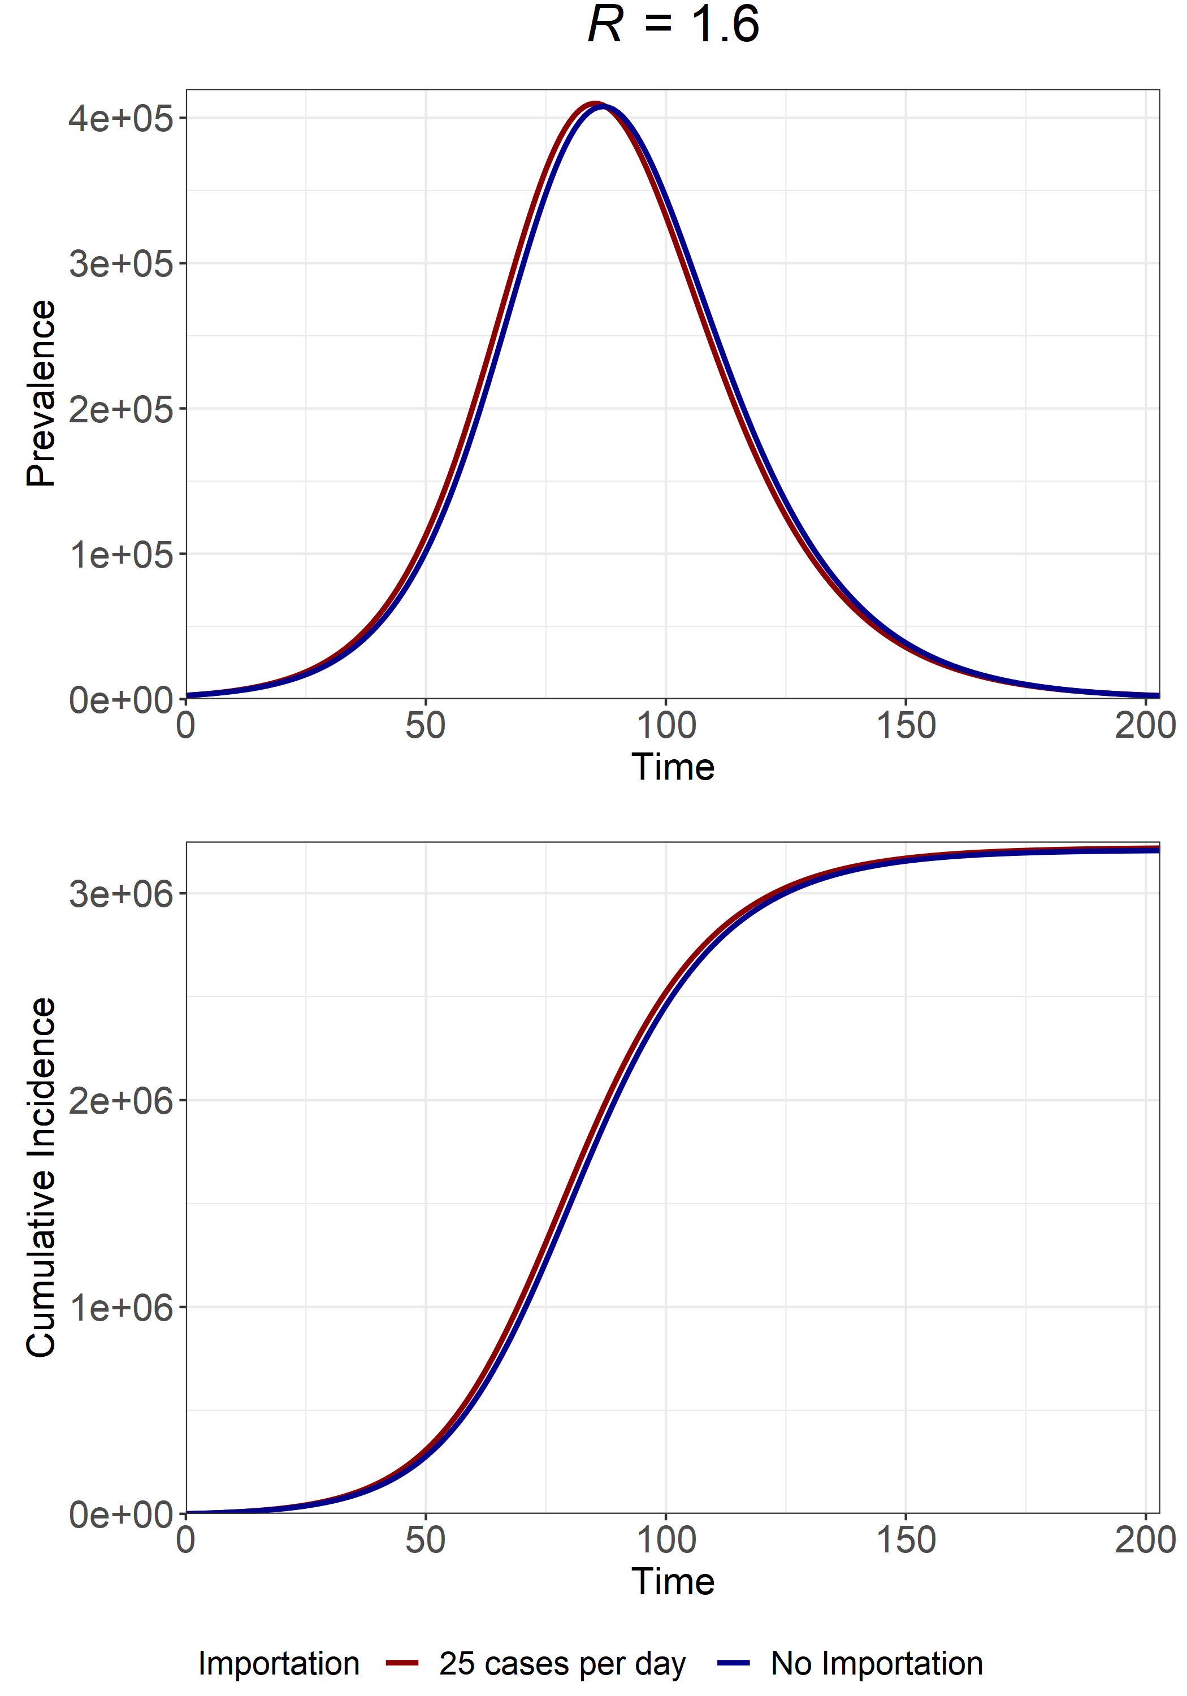
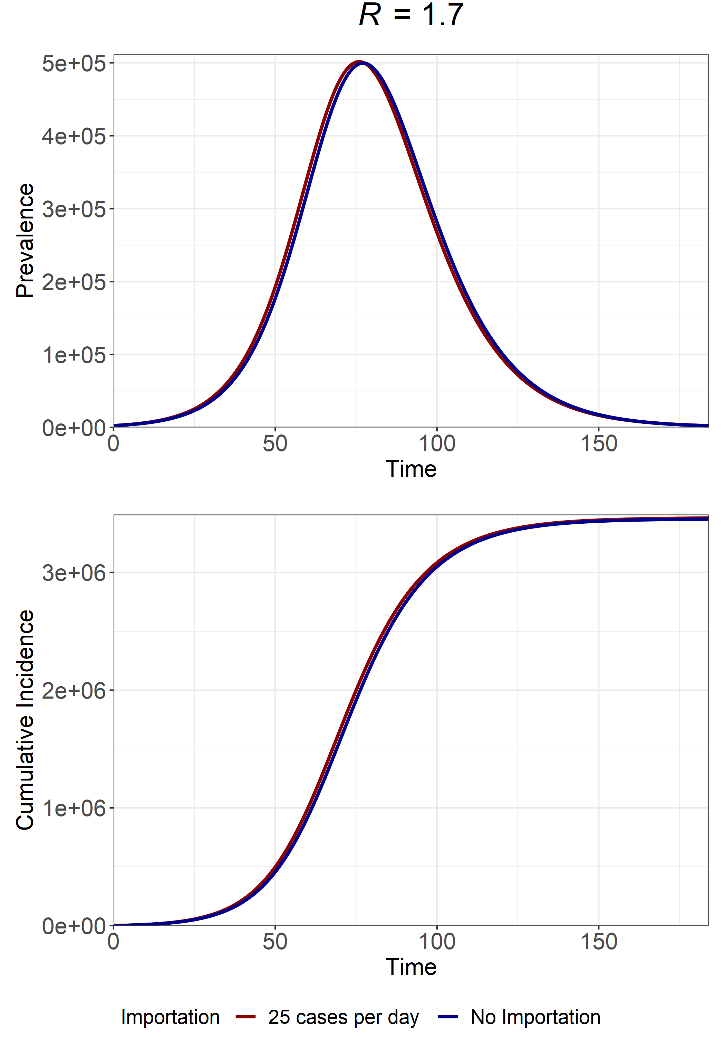
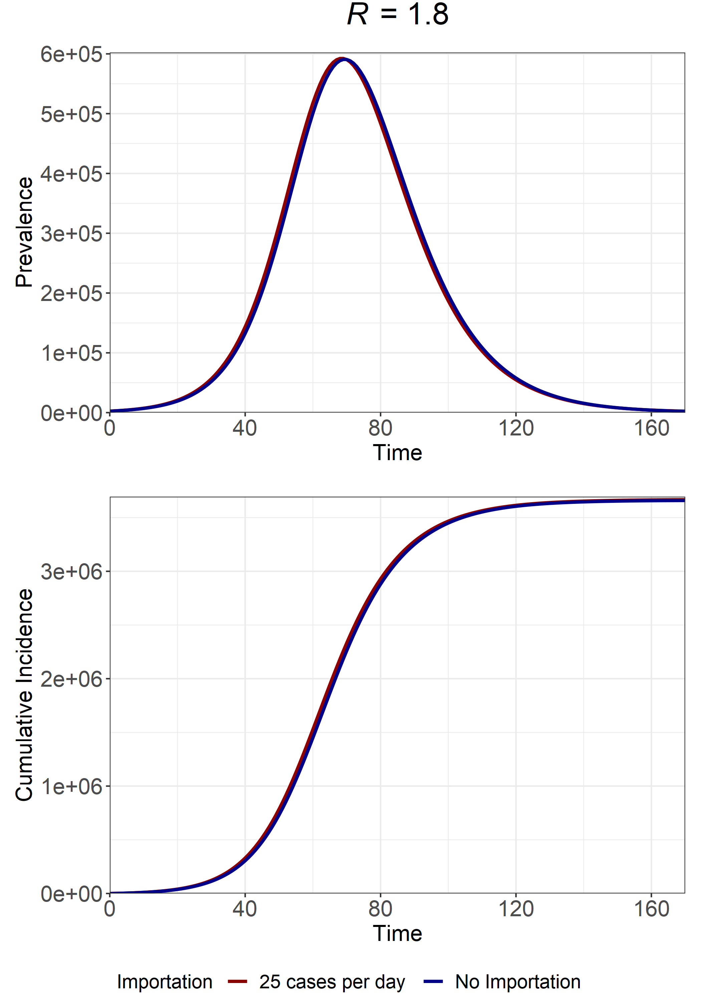
R
1.5
1.6
1.7
1.8
Final Size at I(t) = 2500
Importation = 2924856 cases
No Importation = 2910194 cases
Importation = 3217700 cases
No Importation = 3206231 cases
Importation = 3461817 cases
No Importation = 3452429 cases
Importation = 3666562 cases
No Importation = 3658654 cases
Fraction of Epidemic w/ Importation attributable to Importation?
0.005%
0.003%
0.003%
0.02%

Slide 4
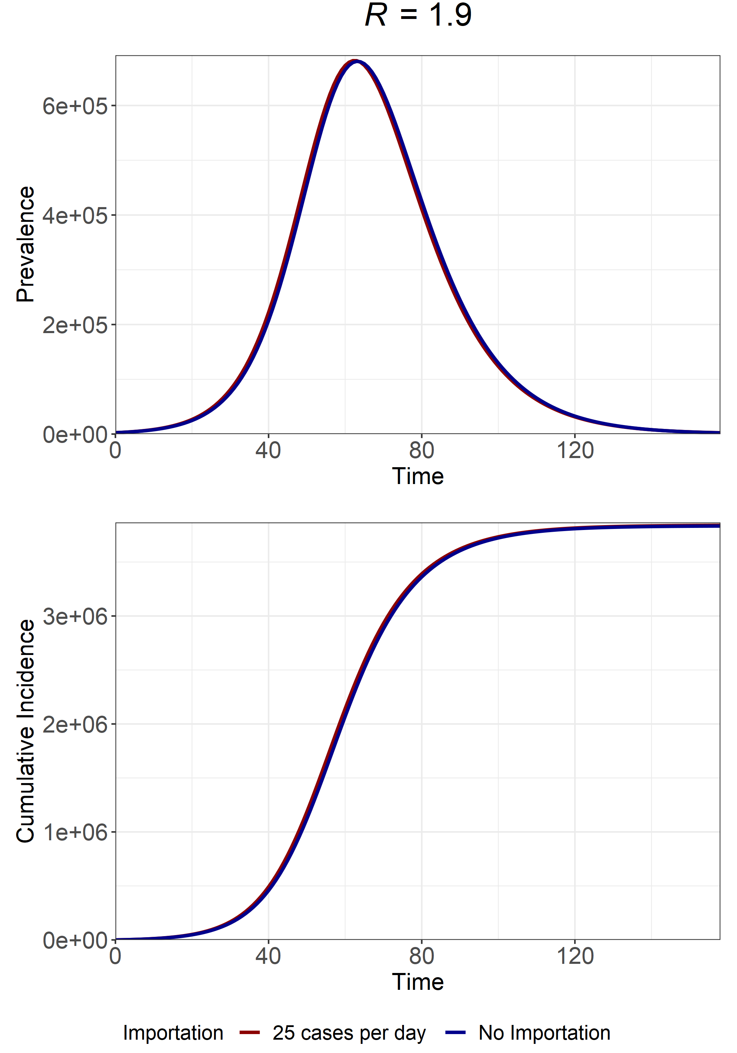
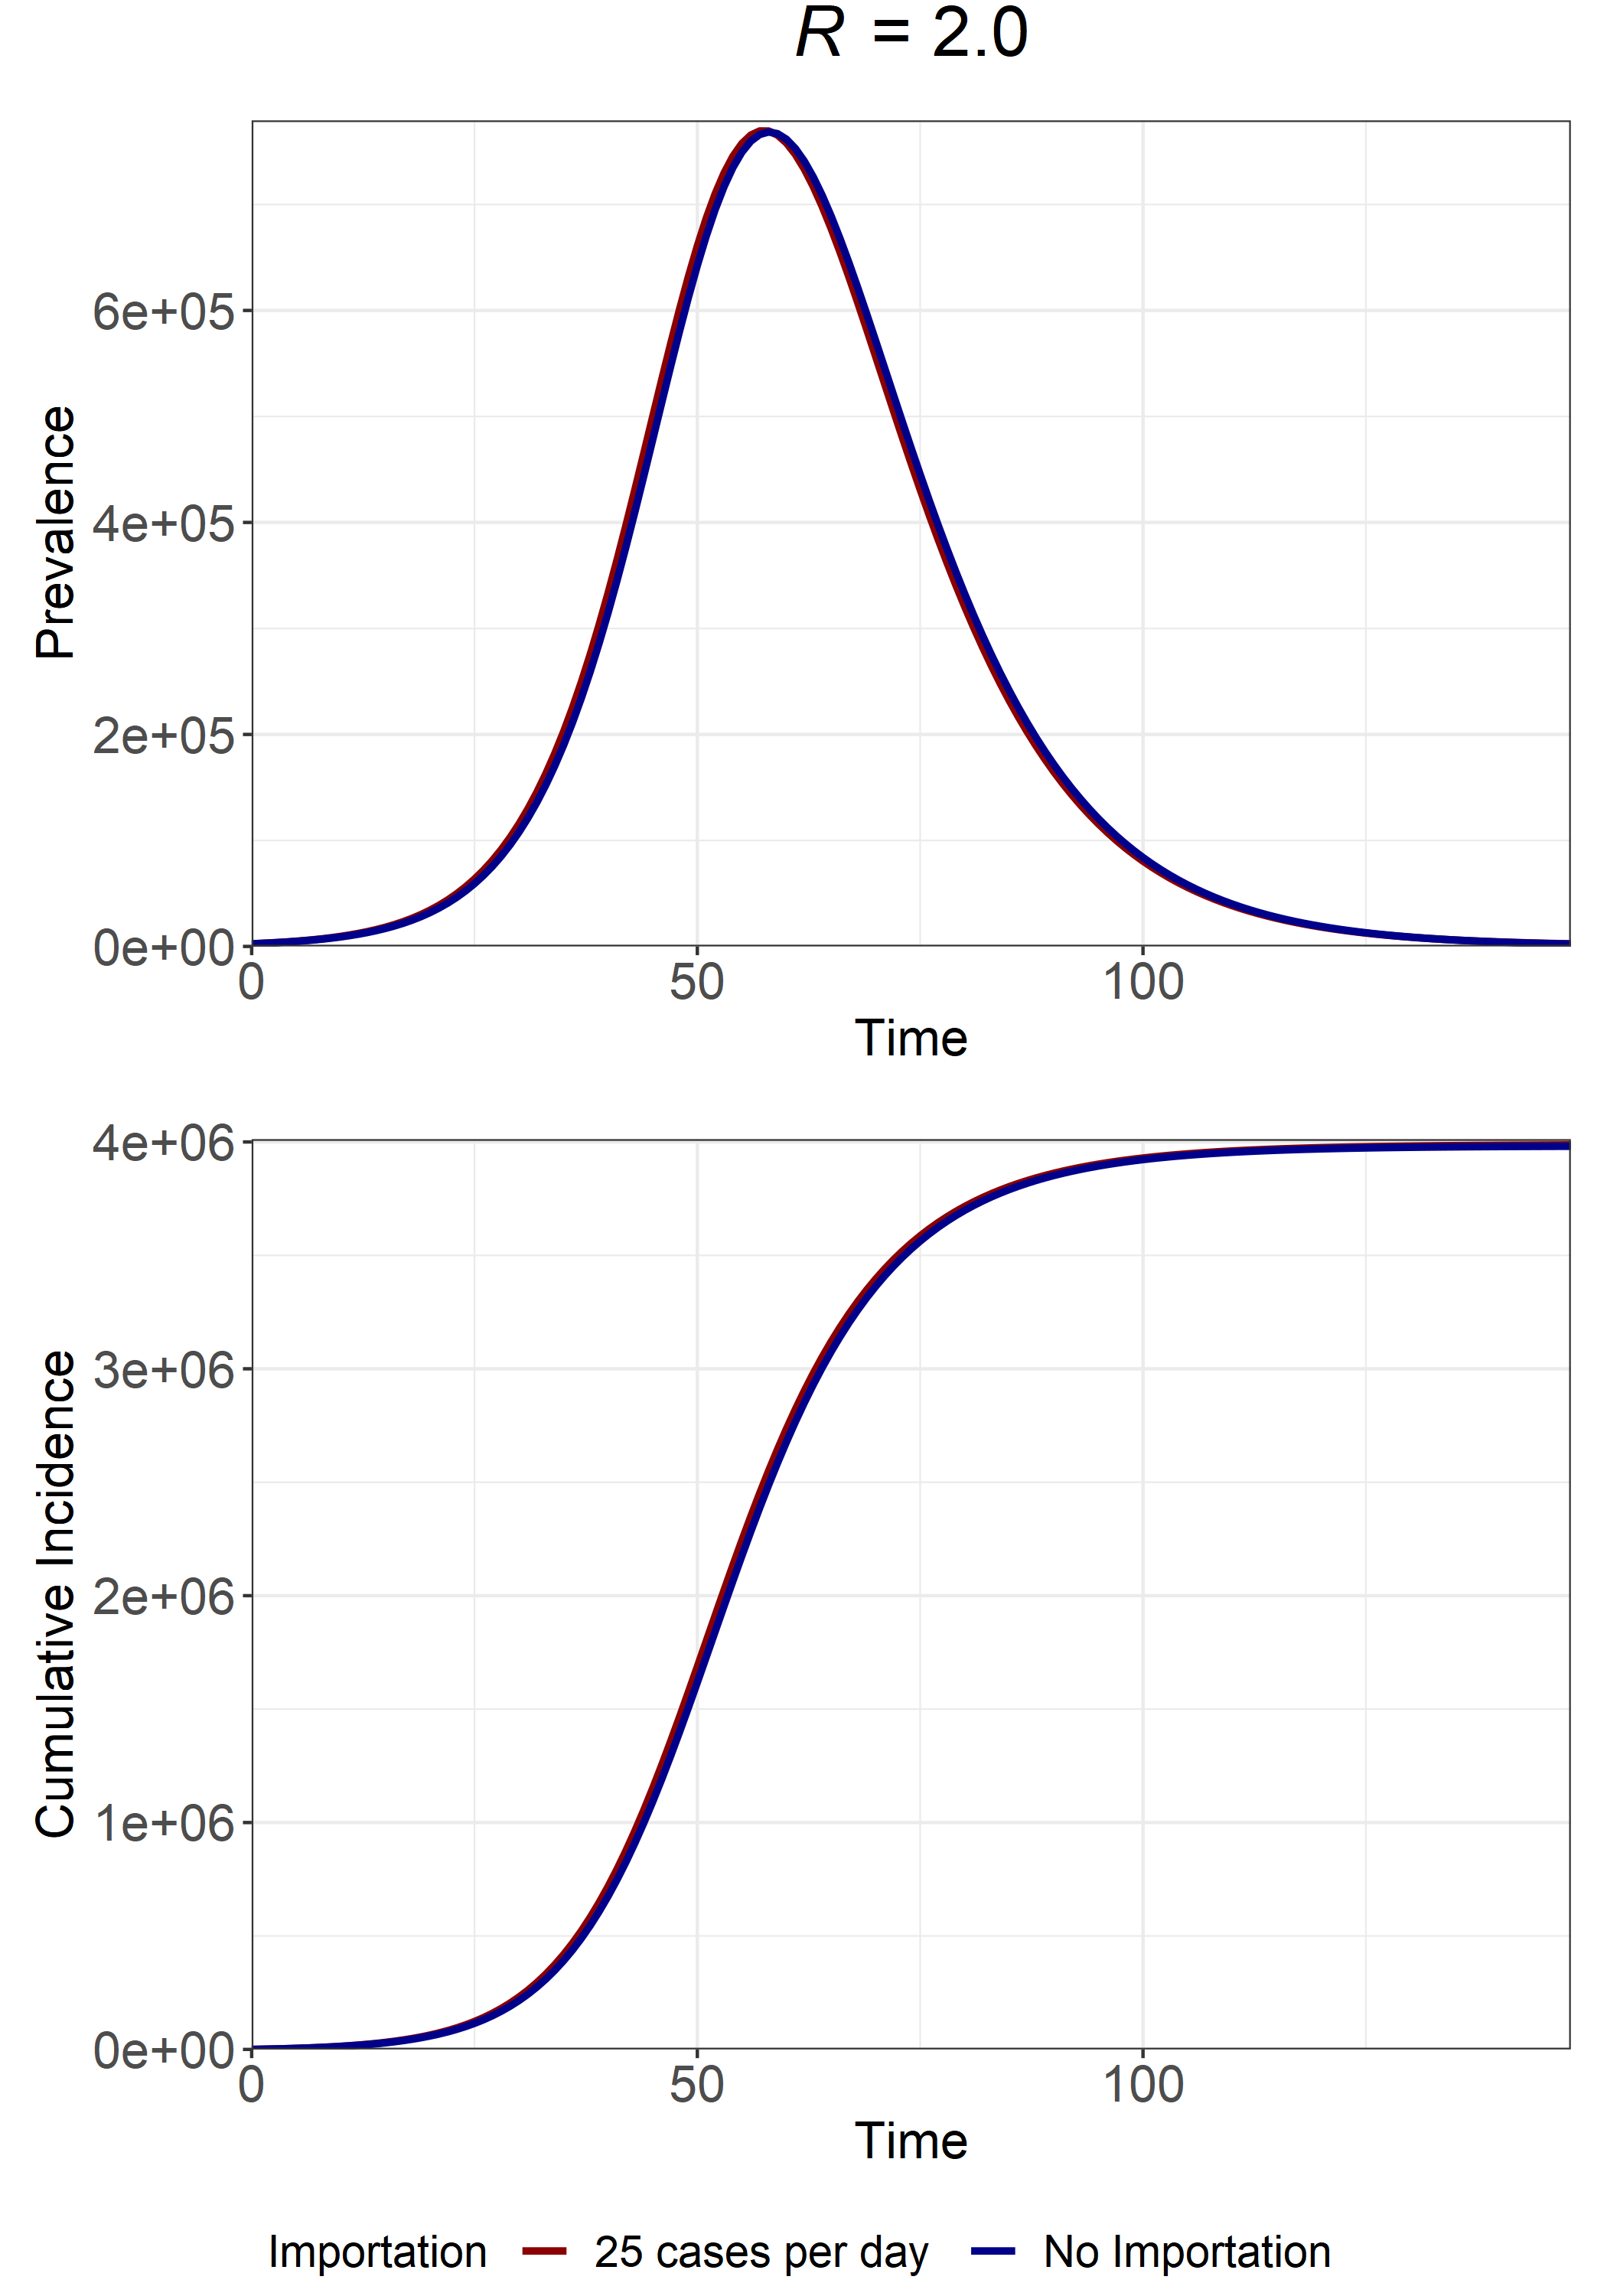
R
1.9
2.0
Final Size at I(t) = 2500
Importation = 3839764 cases
No Importation = 3832896 cases
Importation = 3986805 cases
No Importation = 3980756 cases
Fraction of Epidemic w/ Importation attributable to Importation?
0.002%
0.002%

